Slide 1
Welcome to the
Presentation of
Web App Based Tuition Media

Slide 2
Web App Based Tuition Media
Contributions of Different Members :
Afridi Ibn Rahman : https://github.com/afridirahman97
Jasarat Zaheen : https://github.com/Jasarat19
Subhi Bhuiyan : https://github.com/SubhiBhuiyan

Slide 3
Story Behind The Idea
Home Tutoring is a common phenomenon in Bangladesh. usually, home tutoring job offers are posted in various Facebook groups. But these Facebook groups often fail to establish a proper communication between the interested tutors and the intermediary media. So, We thought of an idea to create a separate platform that will serve as the easiest modern process of posting home tutoring openings where there will be better communication through proper informations, better credibility of the jobs as well as the interested tutors.

Slide 4
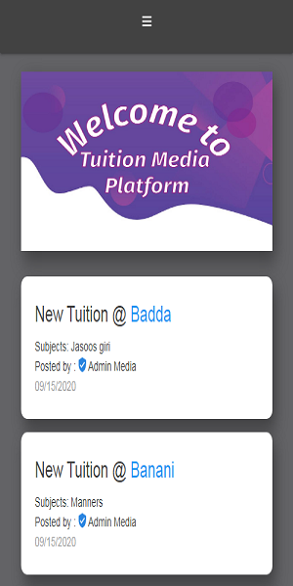
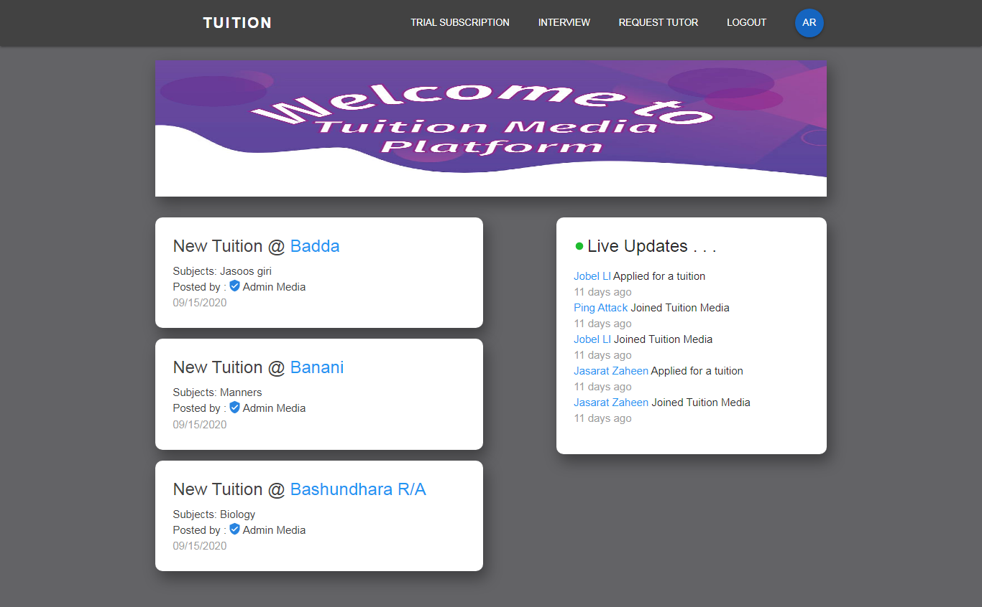
How will the System Work ?
Tutors and students will first register themselves to the system from any device.
Tutors will search for jobs and apply for it if they find a suitable job.
Media will check the tutor’s background through this system and will notify them if they are selected for the job.
Students will request for a tutor to the media through the system.

Slide 5
Requirement Analysis
Functional Requirement:
The system will record information details of the students and tutors.
The system will record the user registration-fees.
The system will enable students to create tuition offers according to a specified format.
The system will display offers adhering to the specified format.
The system allows tutors to search and browse tuition offers by subjects of interest.
The system will allow tutors to know if an offer is available or not.
The system enables tutors to up-vote their interest in the listed offers.
The system shall notify the tutors if they are selected for a tuition offer.
The system enables tutors to schedule their viva appointment online.
The system will record commission received from tutor’s first salary as stated in the contract.
The system will keep track of the free one-year trial subscription of the registered students.

Slide 6
Requirement Analysis Cont.
Non-Functional Requirement:
Operational
1.1 The system should run on PCs, tablets and other handheld devices.
1.2 The system should integrate with existing tuition-media management system.
1.3 The system should be able to work on any Web browser.
Performance
2.1 Any interaction between the user and the system should not exceed 2 seconds.
2.2 The system supports 500 simultaneous users from 9-12 A.M. ; 100 simultaneous users all the time.
2.3 The system should be available to use throughout the year.

Slide 7
Requirement Analysis Cont.
Non-Functional Requirement:
3. Security
3.1 No unauthorized person can access the database.
3.2 Only authorized personnel can see and edit the detailed information of the records.
3.3 Only authorized personnel can approve tuition offers.
3.4 The system includes all available safeguard from viruses.

Slide 8
Requirement Analysis Cont.
Non-Functional Requirement:
4. Cultural and Political
4.1 Personal information of students and tutors are protected in compliance with the Data Protection Act.
4.2 System available in English and Bangla languages.
4.3 Data centers located in Bangladesh.
4.4 Tuition-media company reserves the right to adopt legal actions if unethical approaches are taken by the users.

Slide 9
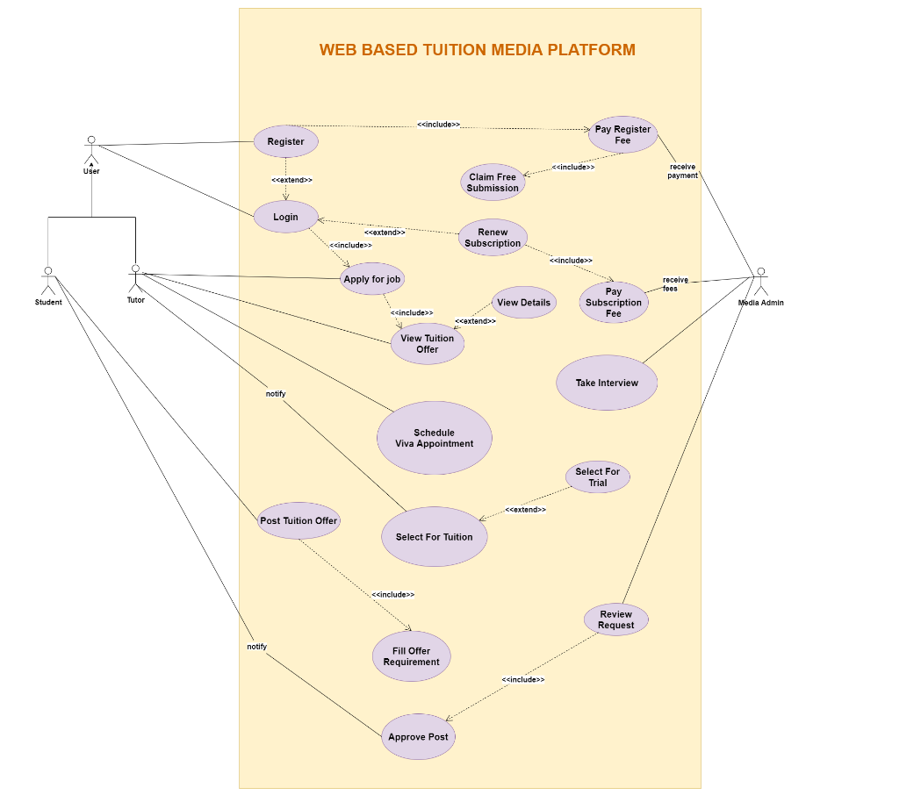
Use Case Diagram

Slide 10
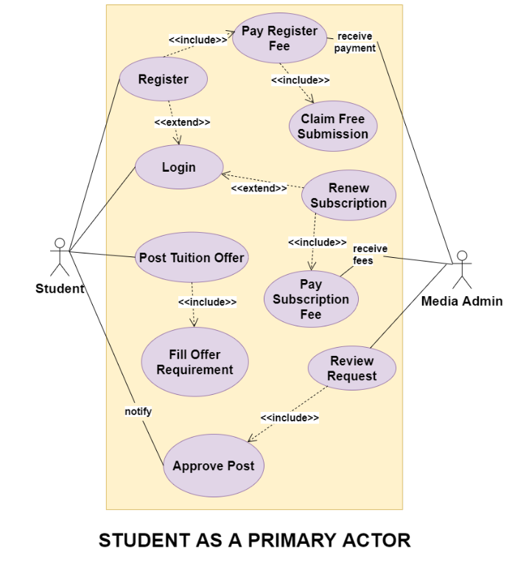
Use Case Diagram Cont.

Slide 11
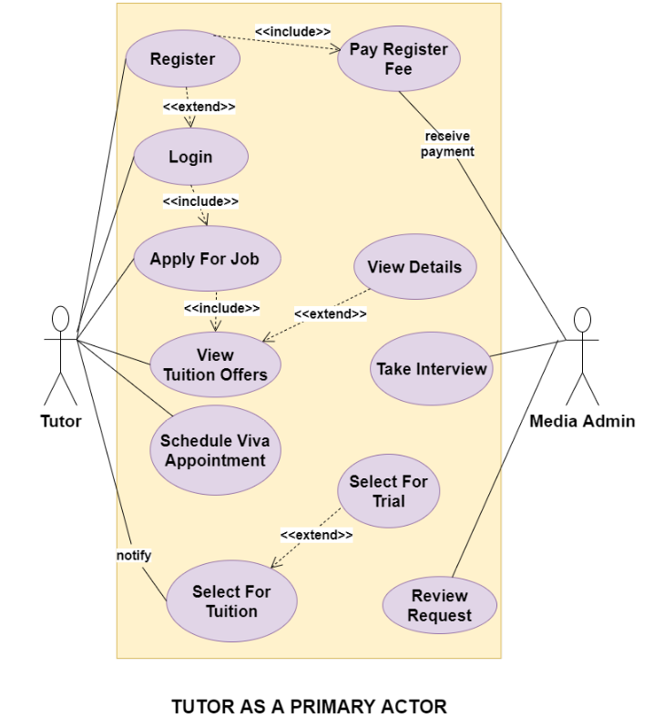
Use Case Diagram Cont.

Slide 12
Sequence Diagram

Slide 13
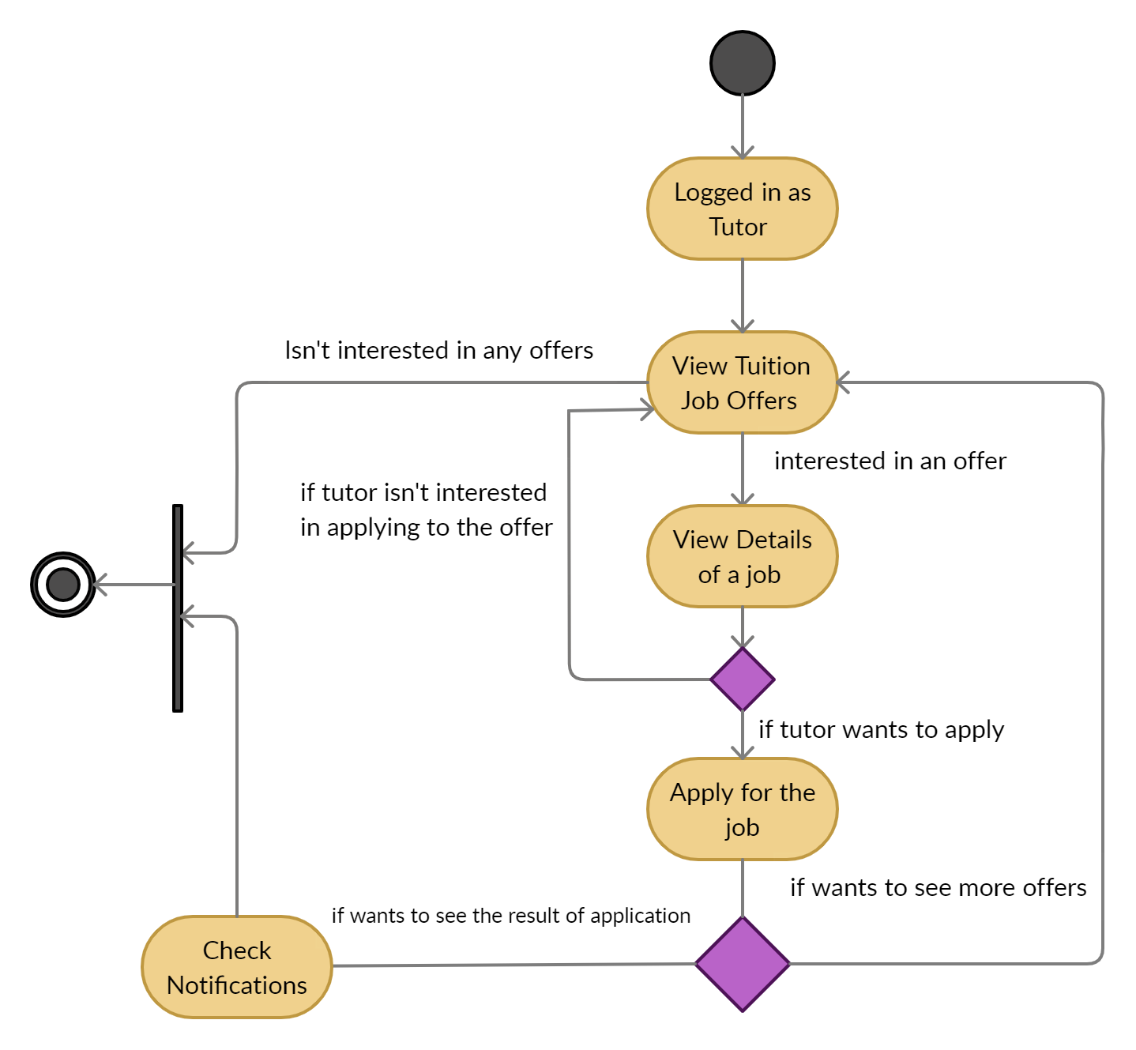
Activity Diagram for Tutor

Slide 14
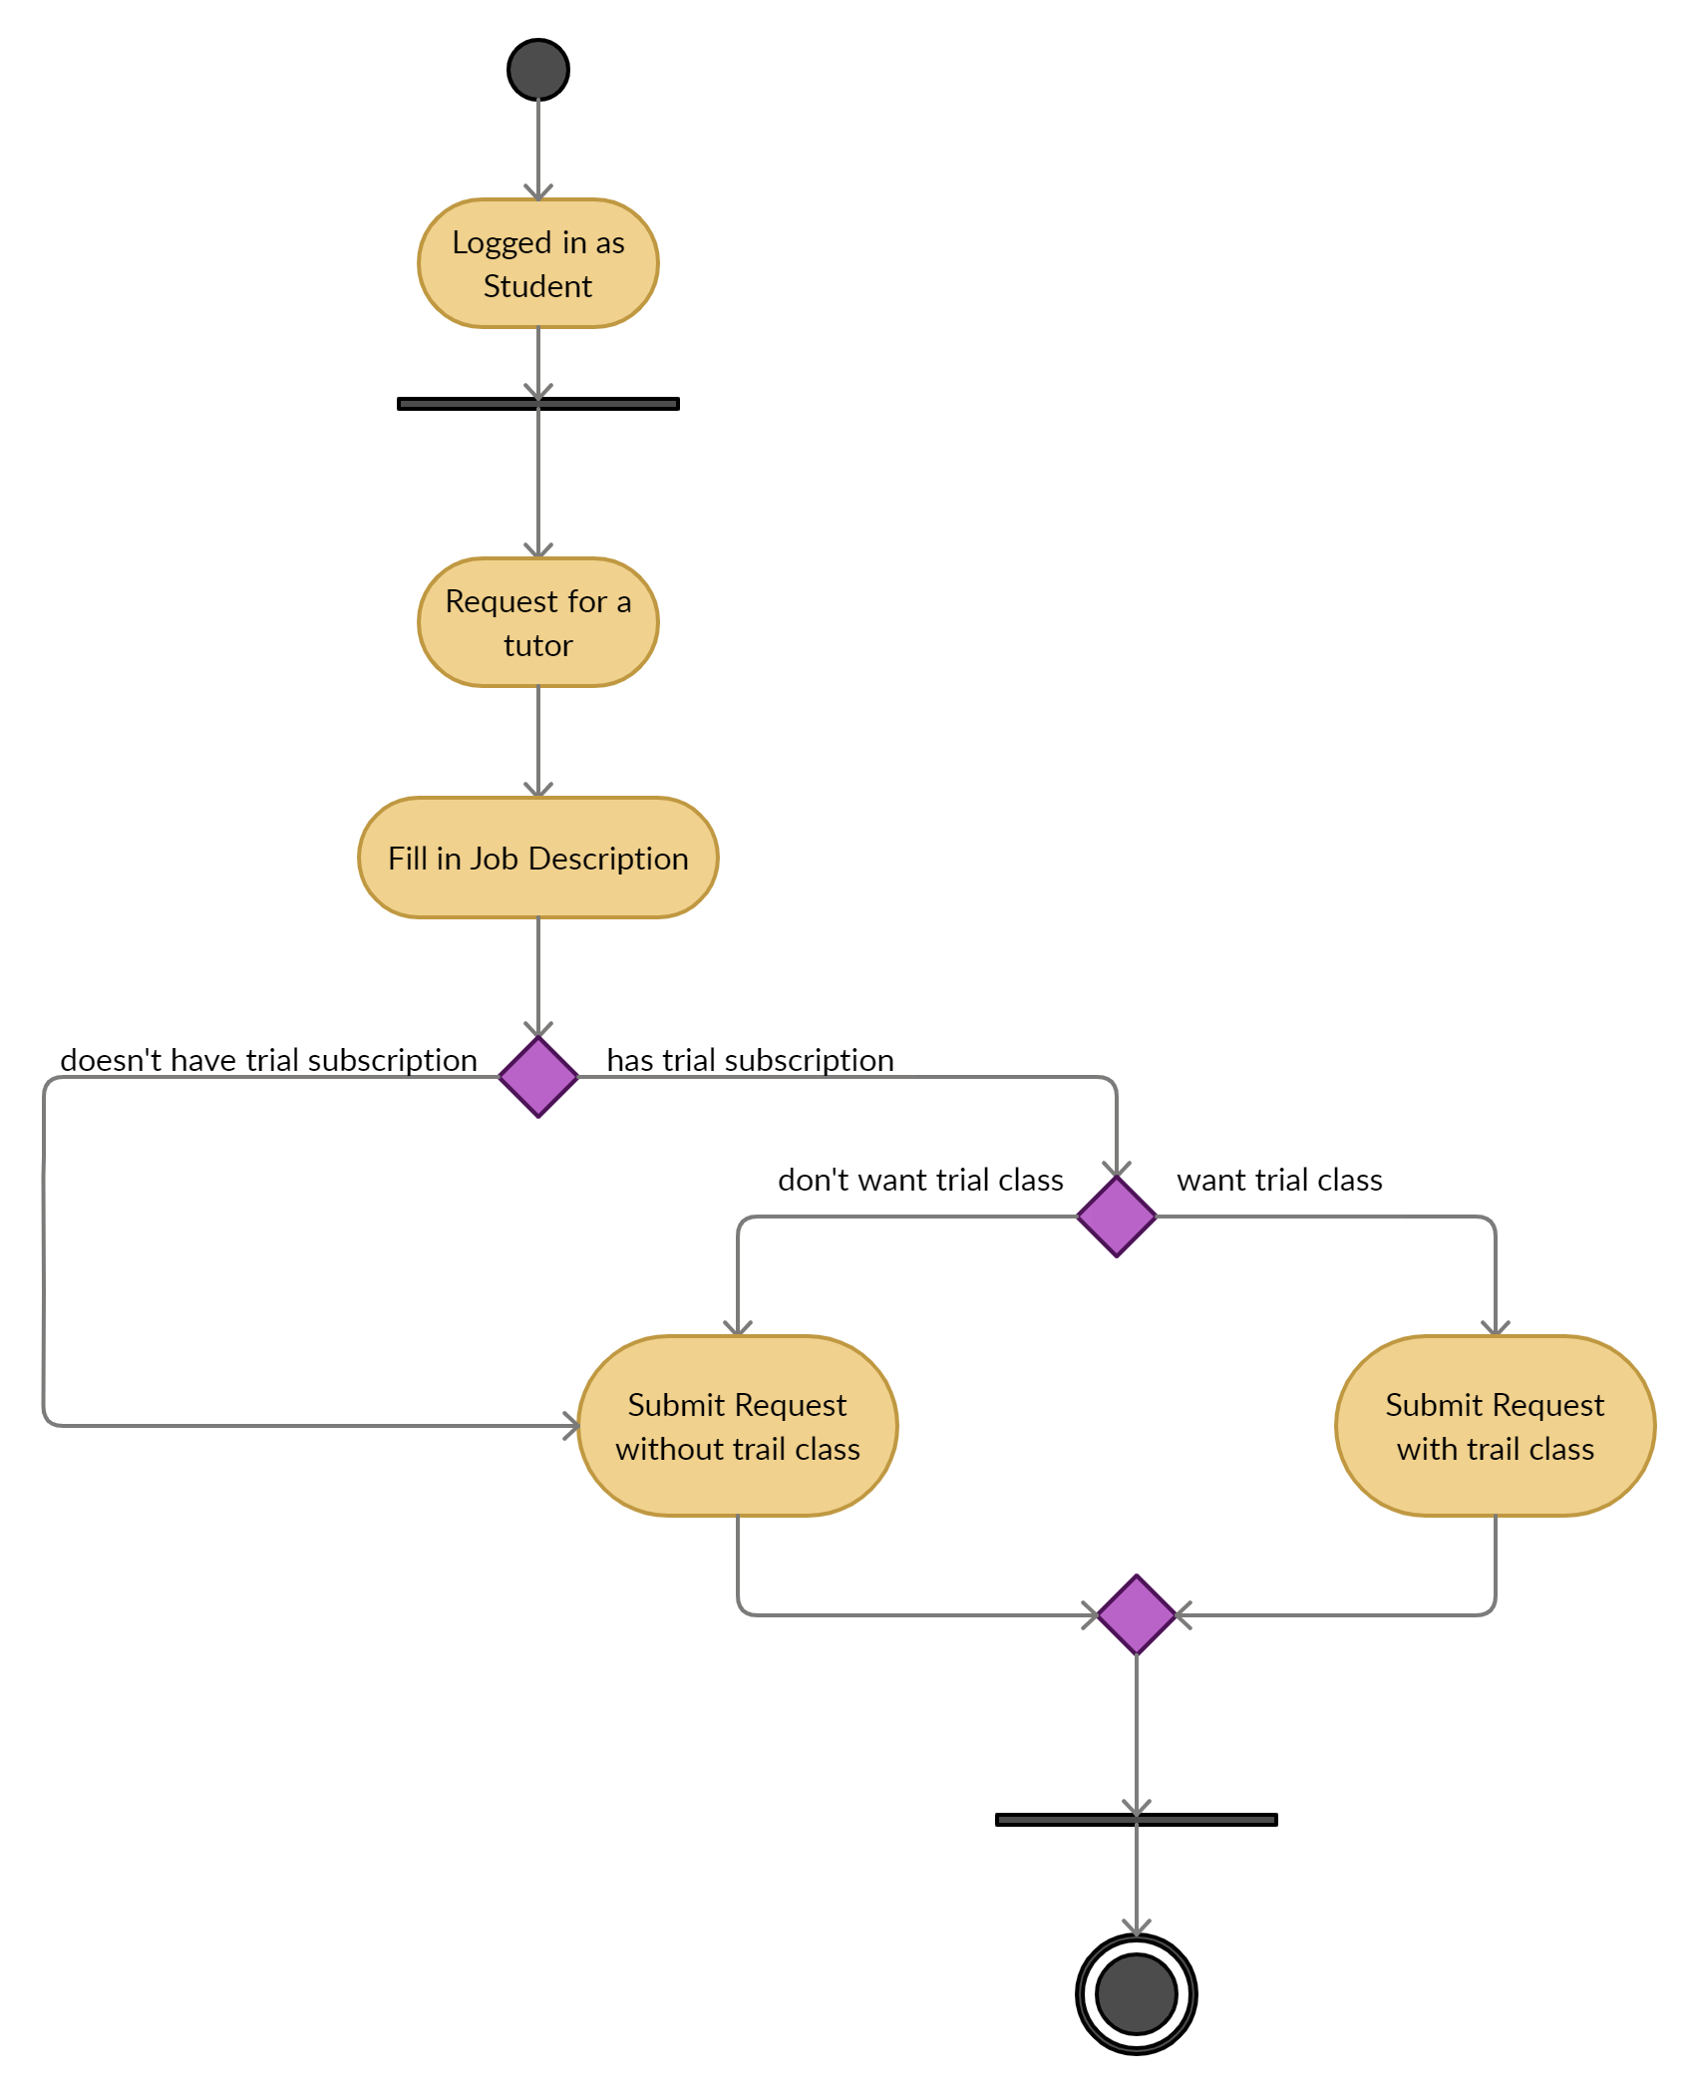
Activity Diagram for Student

Slide 15
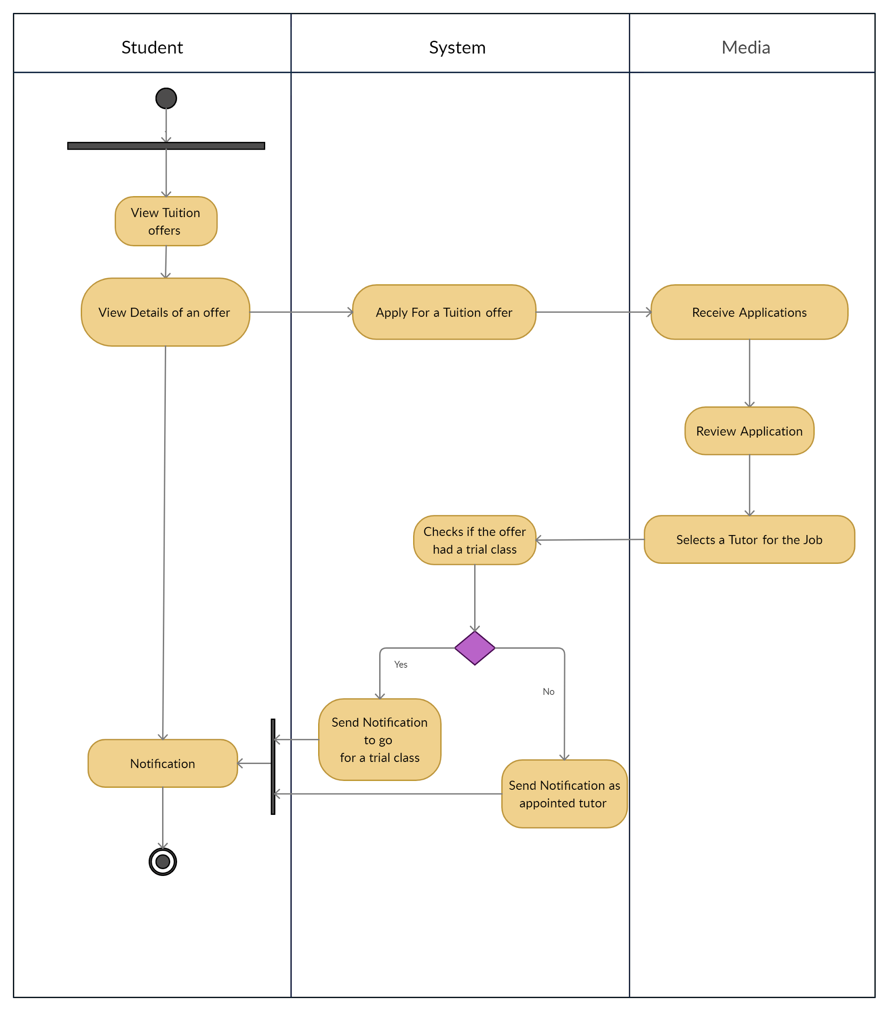
Swimlane Diagram for Tutor

Slide 16
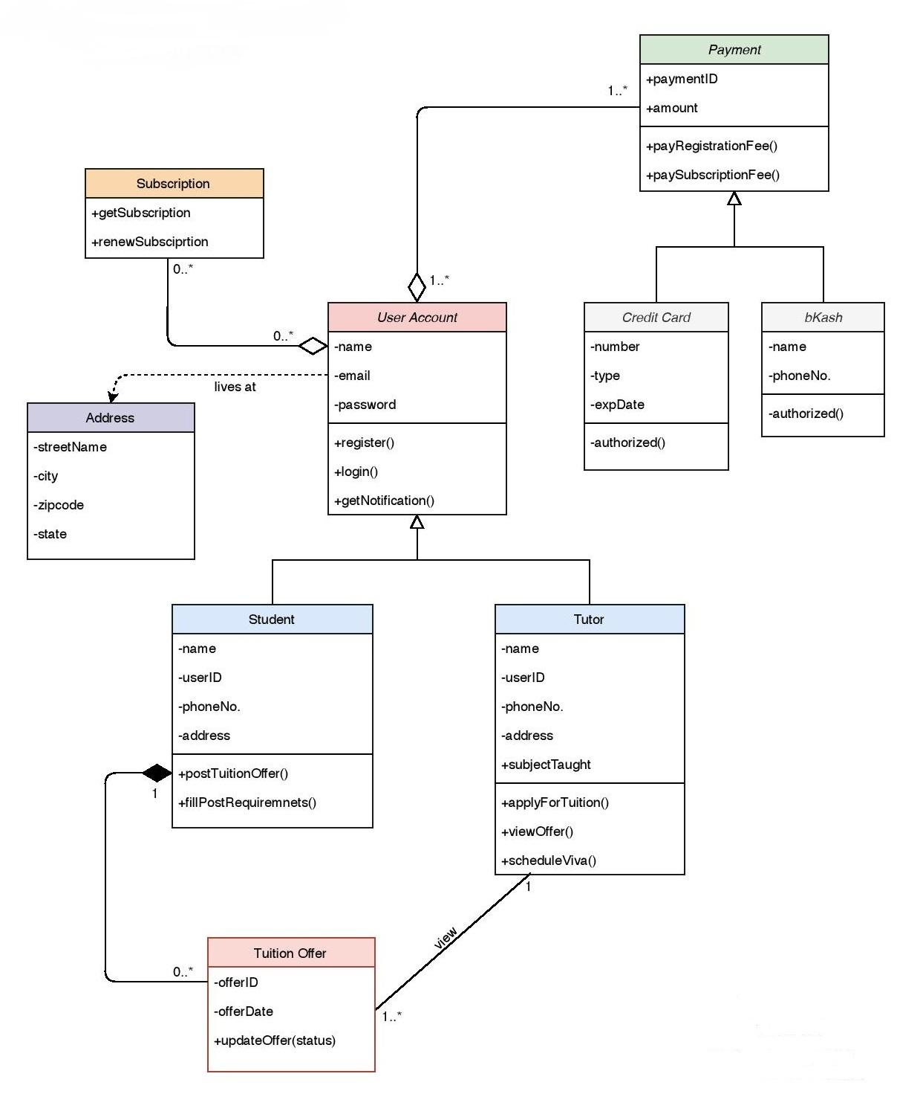
Class Diagram

Slide 17
DFD Context Diagram

Slide 18
DFD Level-1 Diagram

Slide 19

Thanks!
We Hope that you enjoyed it

